Slide 1
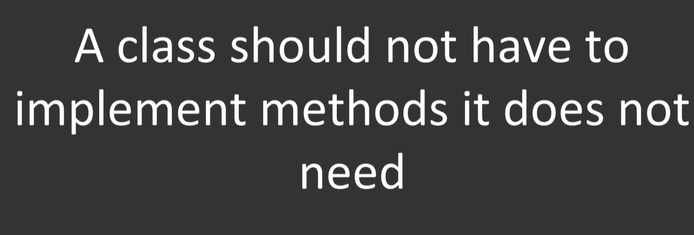
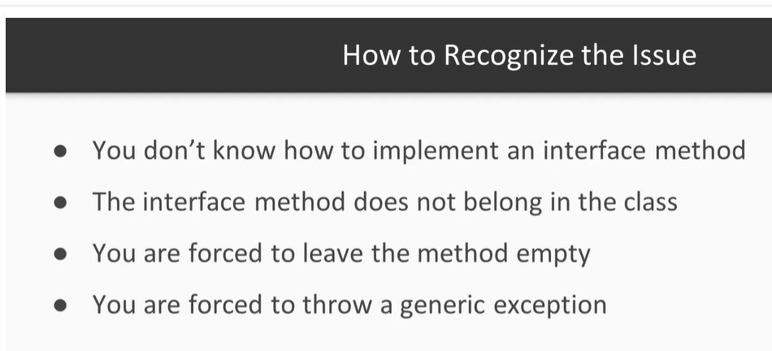
Interface Segregation:Not a problem but desirable outcome otherwise code smell(class force to implement a method of parent in child which doesn’t need ) happens. Eg penguin class need to implement fly() method of Ibird interface
To avoid penguin issue, split IBird into IEat, Iflyable, Iwalkable, now IEat can be widly used even by a animal, bird, penguine or mamles class, that the beauty of segregation, similarly Iflyable can be used by bird, Airplane etc

